Slide 1

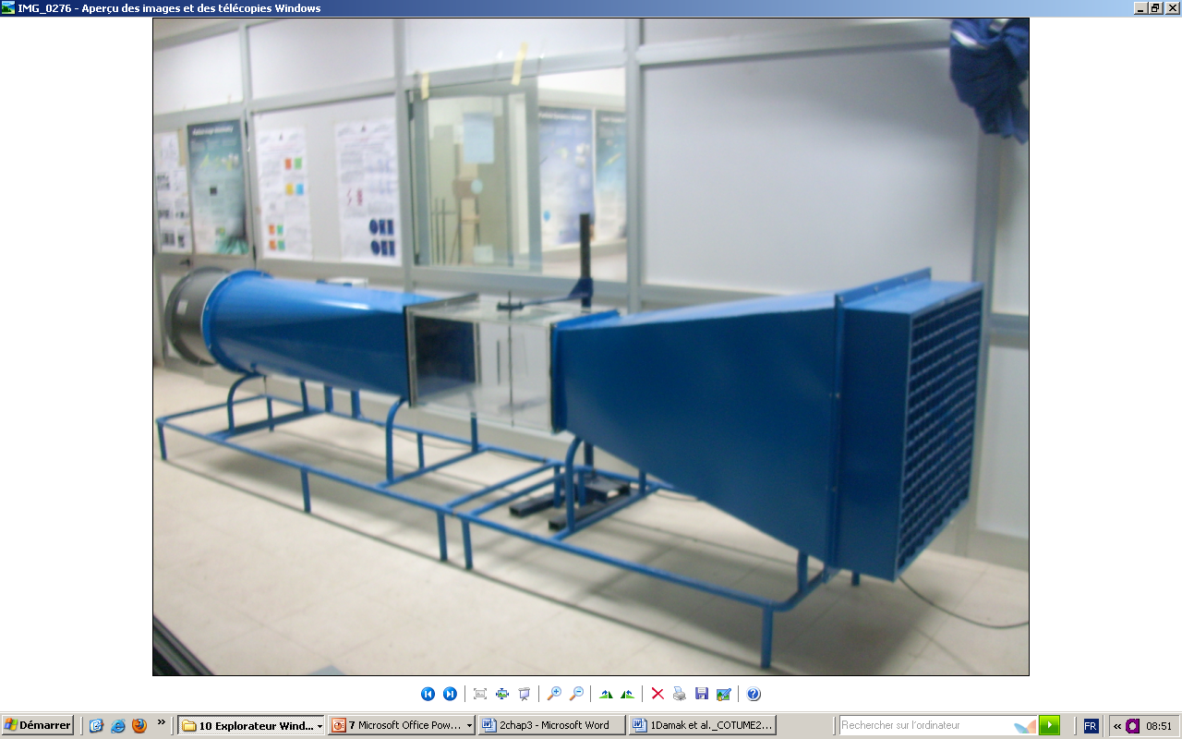

The Second National Conference on Applied Sciences and Engineering 2025 (NCASE 2025‎)
Title Paper Format
Full Name Author1¹, Full Name Author2²
¹ Affiliation and mailing address of Author 1
² Affiliation and mailing address of Author 2
Abstract
The instructions in this document are guidelines for preparing a POSTER for submission to ICME’2019. This document can be used as a Power Point template.
The size of the poster is 60 cm by 90 cm
Title paragraph: Arial 32 ; Bold
The subtitles: in italic, Arial 26 ; Bold
Paragraph text: Arial 24
Title 2
Mention here your:
- results
- Discussions
Title figure format
Title 1
Tables and figures must be presented according to the following models. You must specify the number and the title.
Title figure format
Title Table format
Model | P_{n} [W] | Ø [m] | V_{d} [m/s] | V_{n} [m/s] | V_{c}[m/s]
C1: Cyclone 1kW | 1000 | 2,7 | 2,5 | 9 | 15
sky: Skystream 3.7 | 1800 | 3,72 | 2,5 | 9 | 25
C3: Cyclone 3kW | 3000 | 4,5 | 2,5 | 10 | 15
Title figure format
Conclusion
Mention here your:
- Conclusion
- next works
The Second National Conference on Applied Sciences and Engineering 2025 (NCASE 2025‎)

